Slide 1
James Croft - Document Data Extraction with Azure AI

Slide 2
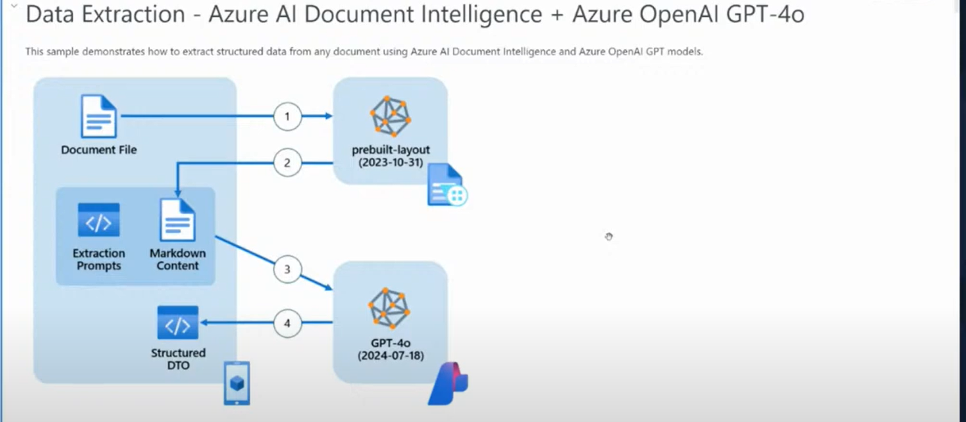

Slide 3
